Slide 1


Connect for Success -
A Title I Digital Enterprise
Laptop Use Training

Slide 2
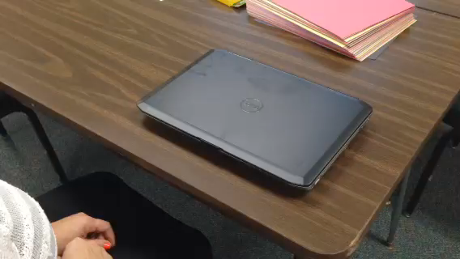
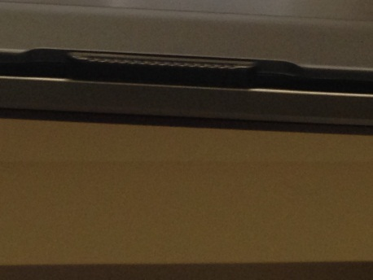
How to open up your laptop…
Put your thumb on the laptop lock and move it to the right.

Slide 3
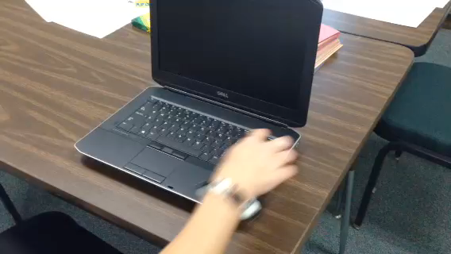
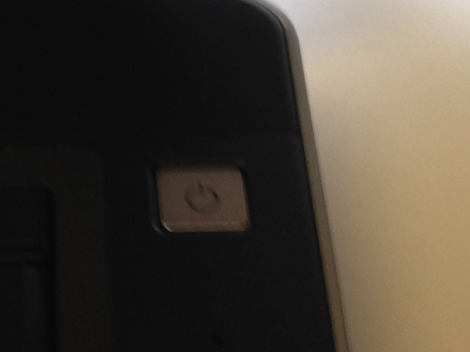
How to turn on your laptop…
Push the on button

Slide 4
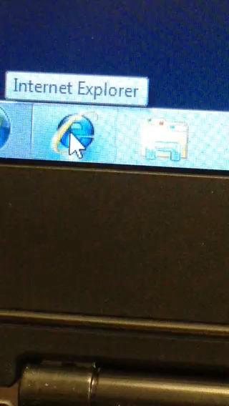
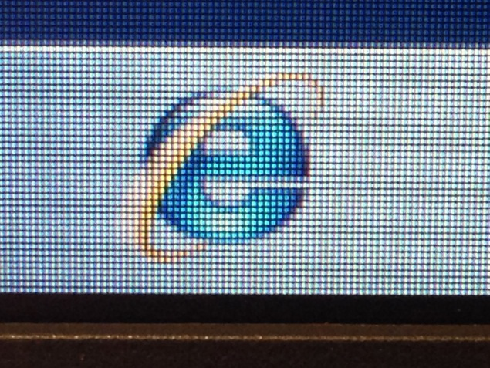
This is the fun stuff.
How To Get to the Connect for Success Title 1 Digital Enterprise Home Page…
Move the mouse pointer to Internet Explorer. Internet Explorer will be in the lower left corner of the screen on the taskbar.
Then single click on Internet Explorer

Slide 5
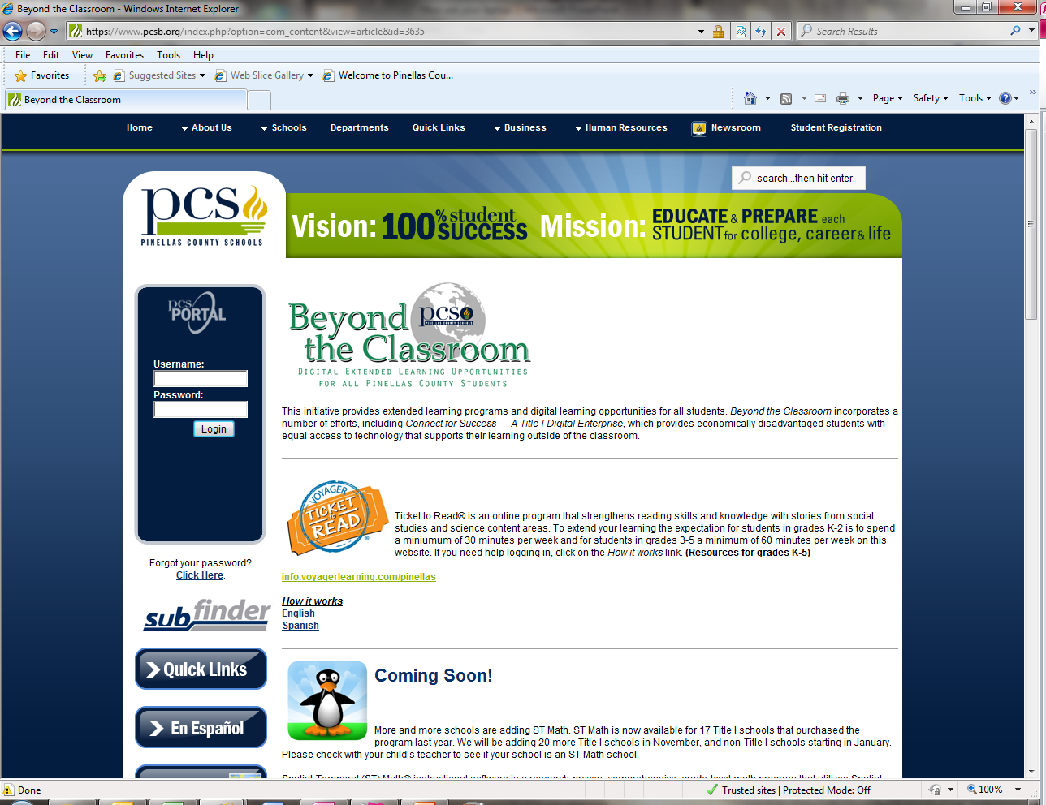
Your computer screen will look like this…

Slide 6


How To Access a Software Program…
(Example: i-Ready)
This is a program for students at Title I schools that are in the Promise Time Program for the 2015-16 school year. Students are to continue working in i-Ready on their Connect for Success laptop at home using their i-Ready login. If a student is not enrolled at a Title I school or in Promise Time, their PCS usernames and passwords will not work. This program is for reading and math grades K-8.
https://login.i-ready.com/
Just move the mouse point to the i-Ready link and click to start the program.
Click me for English
To learn how i-Ready works.
Click me for Spanish

Slide 7









Other “Connect for Success” Software Programs
ST Math

Slide 8



Other Programs Available on Your Desktop…
Microsoft Excel is a spreadsheet application.
Microsoft Word is a word processor
Microsoft PowerPoint is a presentation program.

Slide 9
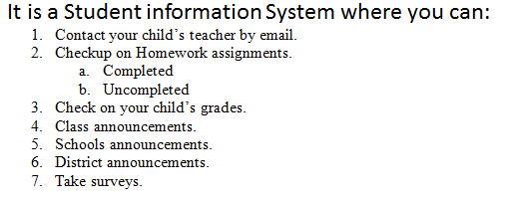

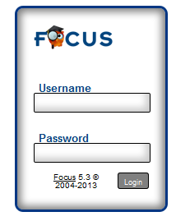
Portal/Focus…
For Parents:
Use your Parent password issued by the school. For issues, please contact the front office of the school.
For Students:
Use your student Pinellas Domain/Network Credentials (R2.D2) to access. If you are having issues, please contact your teacher.

